Slide 1
Delta Schools Curriculum and Digital Learning:
Delta’s Education Partner Houghton Mifflin Harcourt (HMH) is a global leader in K-12 educational content and services, combining digital innovation and research to make learning more engaging and effective.

Slide 2
Think Central HMH - Grades K - 6
Think Central is the (HMH) Web site that allows teachers and students to access digital materials associated with one or more HMH programs, Mathematics, Science (till grade 8) and English Language. It also allows administrators to set up assignments, homework and tests in Things To Do. Student may explore and benefit from the resources in My Library such as books, movies, sound files, worksheets, and more. It also generates instant reports and grades in My Scores.

Slide 3
Holt McDougal HMH - Grades 7 - 12
Holt McDougal Learning connects students to our Online Editions, Essay Scoring, Quantum Artificial Intelligence Tutors, and other exciting new eLearning resources for the programs Mathematics, Science (biology, chemistry & physics) and English Language. It allows students to access eBook , online version of the book, and students resources that contains labs, worksheets and English learners resources. It also allows students to navigate through interactive reader, multimedia labs and activities, videos, data analysis and virtual labs.

Slide 4
Bien dit HMH - Grades 6 - 11
Bien dit! is a highly interactive French curriculum that features a powerful blend of culture, instruction and the latest technology. It contains audio files to help students with the pronunciation.
Le Loustic - Grades 1 - 5
Le Loustic is an easy to use course for children with a focus on spoken French which conforms to various beginners French programs.

Slide 5
Into Social HMH - Grades K - 6
Into Social Helps students develop the strong contextual foundations and build knowledge and find their place in the world with our dynamic social studies curricula. Into Social Studies explores the past and present, inviting learners to tackle challenging questions about our global community
World History & World Geography HMH - Grades 7 - 12
Into Social Helps students develop the strong contextual foundations and build knowledge and find their place in the world with our dynamic social studies curricula. Into Social Studies explores the past and present, inviting learners to tackle challenging questions about our global community

Slide 6
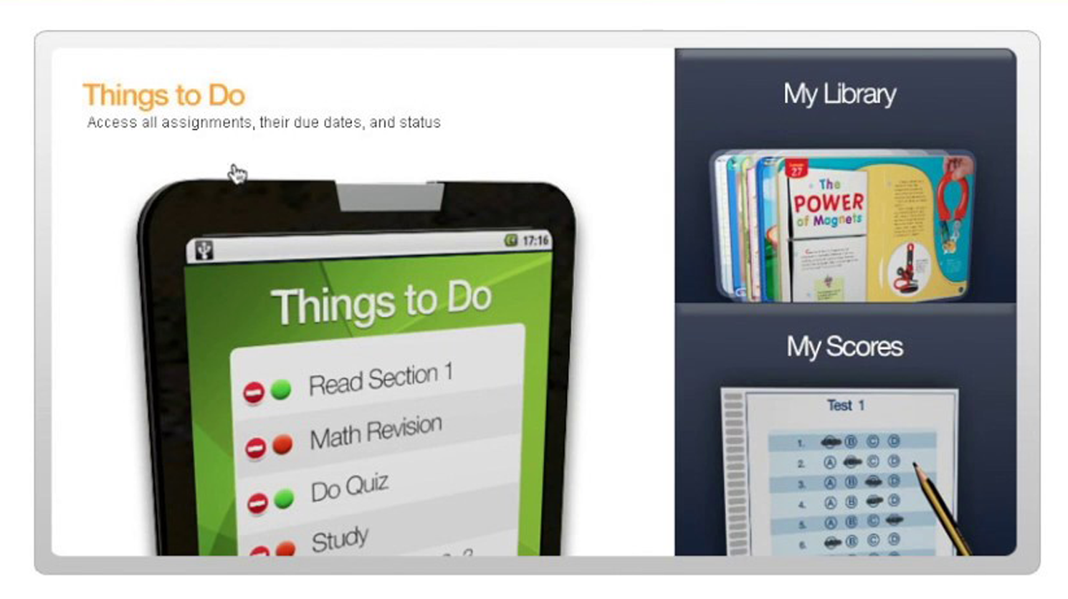
How can the student access Think Central?
In the ThinkCentral login screen, select your state from the State dropdown list.
Select your district from the District dropdown list.
Select your school from the School dropdown list.
Enter the User Name in the entry field.
Enter the Password in the entry field.
Click Login to access your ThinkCentral account.

Slide 7
How can the student access Holt McDougal HMH?
Open Holt McDougal Online by navigating to the following URL: http://my.hrw.com.
Type your Username and Password.
Click Log In.
The Dashboard or My Subscriptions page appears, depending on the setup of your Holt McDougal Online.

Slide 8
مناهج اللغة العربية لغتي- جميع المراحل
مقسم منهج لغتي لثلاثة أقسام ( لغتي للمرحلة الابتدائية الدنيا ) ( لغتي الجميلة للمرحلة الابتدائية العليا ) ( لغتي الخالدة للمرحلة المتوسطة ) .. وهو عبارة عن كتاب للطالب يحتوي على كل مواد اللغة العربية بالإضافة لكتاب النشاط وكتاب خاص بالمعلم به بعض الحلول وطرق التدريس .. تميز لغتي بفكرة دمج مواد اللغة العربية فلم يعد هناك مادة قراءة أو خط أو إملاء .. بل أصبحت مادة واحدة ..​
مناهج الدين- جميع المراحل
تلعب المناهج دوراً مهماً في العملية التربوية إذ تعد المنهل الخصب الذي يزود الطلاب بالمعلومات والمعارف، ويغرس في أنفسهم الاتجاهات والقيم الإيجابية​

